Slide 1

DATATHON 2026
Team: Cushing Street Analytics
Notes:
Good morning/afternoon everyone. We are Cushing Street Analytics, and today we’re going to walk you through our analysis of the NCAA March Madness tournament.
We analyzed 18 years of tournament data — from 2008 through 2025 — to answer three questions: which seeds do well, what stats actually predict success, and who’s going to win it all this year.
Let’s dive in.

Slide 2
Agenda
What we'll cover in the next 8 minutes
01
Seed performance
Which seeds win? How far does each seed go historically?
02
Over & under-performers
Which schools consistently beat or miss their seeding?
03
What predicts success?
It's not shooting stats — it's the résumé.
04
Model & validation
How we built, tested, and scored our prediction model.
05
2026 predictions
Final Four picks from the 16 live teams. Plus: a reality check.
March Madness Datathon 2026
Notes:
Here’s what we’ll cover in the next 8 minutes. We structured our presentation around five sections.
First, we’ll look at raw seed performance — this is just reflecting on historical facts, no modeling involved.
Then we’ll identify which specific schools consistently beat or miss their seeding.
Third — and this was our most interesting finding — we’ll show what stats actually predict tournament success. Spoiler: it’s not what most people think.
Fourth, we’ll explain how we built and validated our prediction model. We’ll keep this accessible — no jargon.
And finally, we’ll make our 2026 predictions for the 16 teams still alive in the bracket.

Slide 3
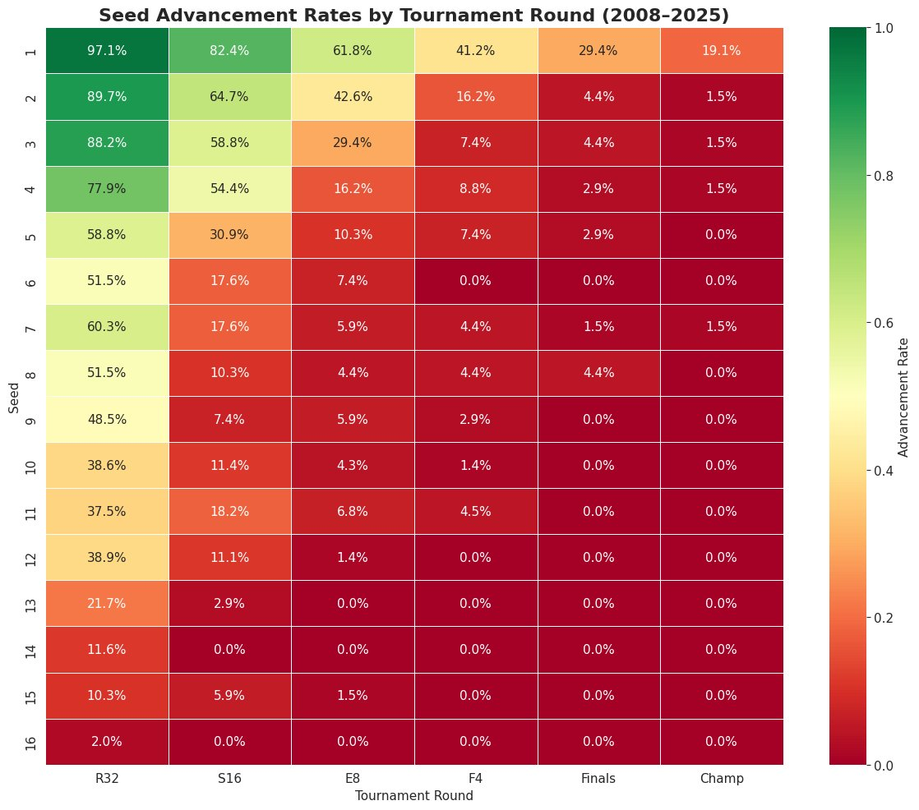
How far does each seed go?
Advancement probability by seed and tournament round
Seed Advancement Rates by Tournament Round (2008–2025)
March Madness Datathon 2026
Notes:
This heatmap is the single most powerful chart in our entire analysis. Every cell shows the probability that a given seed reaches a given round.
Read it left to right: a 1-seed has a 97% chance of surviving the first round, 82% of making the Sweet 16, and about a 1-in-5 shot at winning the whole thing.
Now look at the bottom half — seeds 13 through 16. It’s a wall of red zeros. A 16-seed has literally won just 2 games out of roughly 100 attempts in our dataset.
The interesting zone is seeds 7 through 11 — we call this the chaos zone. Notice that 11-seeds actually reach the Sweet 16 more often than 8, 9, or 10 seeds. That’s the Cinderella effect — those mid-major teams with nothing to lose.
The big takeaway: the tournament is structurally dominated by top seeds. One-seeds account for 76% of all championships since 2008.

Slide 4
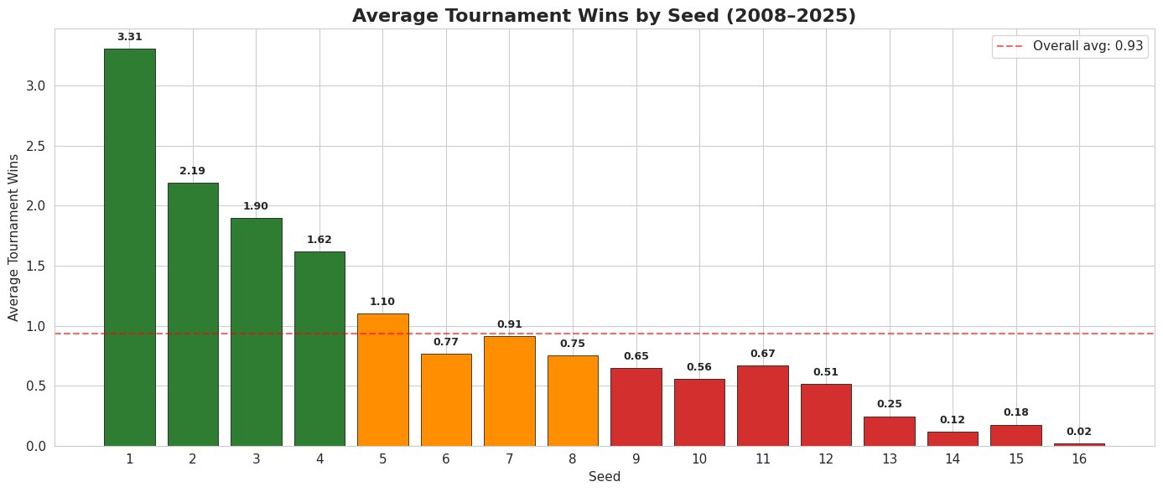
Which seeds do well?
Average tournament wins by seed (2008–2025)
Seeds 1–5 have winning records. Seed 6 is breakeven. Seeds 7+ are underdogs.
March Madness Datathon 2026
Notes:
This bar chart simplifies the heatmap into one number per seed — average tournament wins.
Seeds 1 through 5 are in green — they have winning records. The red dashed line is the overall average of 0.93 wins per team.
Notice something interesting: the 7-seed actually outperforms the 6-seed. That’s because 6-seeds draw 11-seeds in the first round — the Cinderella seed — while 7-seeds draw 10-seeds, which is a more predictable matchup.
The cliff from seed 5 to seed 6 is the sharpest drop on the chart. That’s the dividing line between ’expected to advance’ and ’coin flip.’

Slide 5
Who beats their seed? Who chokes?
Measured by PASE (Performance Against Seed Expectation) — verified by our own manual calculation
OVER-PERFORMERS
UNDER-PERFORMERS
UConn
+13.3
4 titles from seeds 1, 3, 4, 7
Georgetown
−8.1
Avg #5 seed, 0.4 avg wins
Michigan St.
+10.1
17 apps, always exceeds expectations
Virginia
−7.9
Title in 2019, but chronic misses
Butler
+9.2
2 Finals runs as a mid-major
Vanderbilt
−6.3
7 apps, nearly always one-and-done
Michigan
+8.5
Avg #6 seed, plays like a #3
Pittsburgh
−4.8
Ceiling is the Sweet 16
North Carolina
+8.2
Blue-blood consistency
Kansas
−3.3
2022 title doesn’t erase the pattern
March Madness Datathon 2026
Notes:
Now we answer: are there specific schools that consistently beat or miss their seed?
We used a metric called PASE — Performance Against Seed Expectation — which comes directly from the Barttorvik dataset. We also independently verified it by computing expected wins for each seed ourselves and doing the subtraction manually. Both methods produced the same rankings.
On the left — over-performers. UConn is the runaway leader at plus-13.3. They’ve won four national championships from seeds 1, 3, 4, and 7. That kind of range is historically unprecedented.
Michigan State at plus-10.1 — 17 tournament appearances and they almost always exceed expectations. Tom Izzo’s program just performs in March.
On the right — under-performers. Georgetown is the worst at minus-8.1. They average a 4.6 seed but only win 0.4 games per tournament. That’s a program that consistently chokes under pressure.
Virginia at minus-7.9 is notable because they DID win the 2019 title, but one championship doesn’t erase a decade of early exits as a top-4 seed.
Kansas at minus-3.3 might surprise people — but a typical 2-seed should produce more deep runs than Kansas has.

Slide 6
What actually predicts March success?
Our model reveals: it’s not how you shoot — it’s who you beat
MATTERS LESS THAN YOU’D THINK
WHAT ACTUALLY DRIVES DEEP RUNS
✖
Effective field goal % (EFG%)
✔
Resume Score (who you played & beat)
✖
Three-point shooting rate
✔
Wins Above Bubble (quality wins)
✖
Free throw rate
✔
Adjusted efficiency margin
✖
Turnover rate
✔
Conference strength
✖
Tempo (possessions per game)
✔
Prior tournament experience
The takeaway: The tournament doesn’t reward style. It rewards preparation. Teams that scheduled hard, won the games they were supposed to win, and built a body of work against quality competition are the ones that go deep in March.
March Madness Datathon 2026

Slide 7
How we built and tested the model
Gradient Boosting with Leave-One-Year-Out cross-validation
1
DEFINE THE FUNCTION
2
TEST IT 18 TIMES
3
PREDICT 2026
(x₁, x₂, x₃ ...) → rounds advanced
Train on 17 years, predict the 1 year left out. Repeat for every year.
Train a final model on all 1,152 rows. Feed in 2026 regular-season stats.
35 pre-tournament stats go in. Predicted tournament wins come out.
18 separate models → 18 scores → average = our final score.
Every input exists before the tournament starts.
Model performance: Mean Absolute Error = 0.75 wins. On average, our prediction is off by less than one tournament round per team. We tested this across 18 separate hold-out years — the score is not a fluke, it’s the average of 18 independent tests.
March Madness Datathon 2026

Slide 8
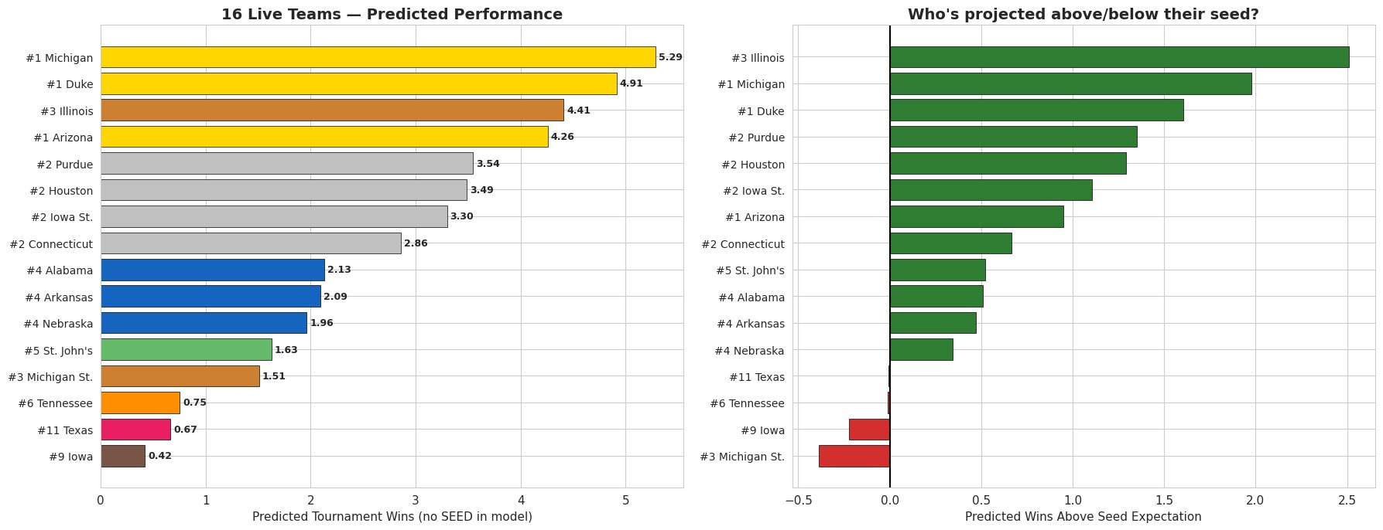
2026 predictions
Predictions based on regular-season stats only
March Madness Datathon 2026
Notes:
Here are our predictions for the 16 teams still alive in the tournament.
The left chart ranks all 16 by predicted wins. The right chart shows who the model thinks is playing ABOVE or BELOW their seed. We can see that Illinois as a 3-seed has the highest wins-above-expectation ,The model sees them as a 1-seed in disguise.
At the bottom we see Michigan State actually projected BELOW their seed expectation. So the model doesn’t love their profile despite the pedigree.

Slide 9
2026 Final Four prediction
Based on pre-tournament data only
🏆
DUKE
ILLINOIS
ARIZONA
MICHIGAN
#1 Seed • ACC
#3 Seed • Big 10
#1 Seed • Big 12
#1 Seed • Big Ten
Midwest Region
South Region
West Region
East Region
4.91
4.41
4.26
5.29
predicted wins
predicted wins
predicted wins
predicted wins
Predicted champion: Michigan over Duke in the final
Upset watch: #3 Illinois, #5 St. John's, #4 Alabama
March Madness Datathon 2026
Notes:
Here’s our Final Four. Michigan wins the tournament over Duke with Illinois and Arizona at number 3 and 4 Michigan’s has highest predicted wins, strong talent composite, and they’re historically one of the biggest over-performers in our dataset. Illinois is the upset watch , as seed 3 disguised as seed 1. Other upset candidates: St. John’s as a 5-seed and Alabama as a 4-seed are both projected above their seed line.

Slide 10
A reality check
Why predictions and reality don’t always match
What our model can do
What no model can do
✔
Identify the strongest teams based on season-long performance
✖
Predict a player getting hot from three in the second half
✔
Quantify which stats matter more than others
✖
Account for injuries, suspensions, or team chemistry
✔
Give us our BEST GUESS at tournament outcomes
✖
Capture the crowd, the pressure, or the moment
✔
Show which seeds and programs have structural advantages
✖
Guarantee anything — Florida was our #4 pick and already lost
March Madness Datathon 2026
Notes:
Our model does a great job at analyzing team stats through the season, highlights the most important stats, gives a best guess based on the previous information It does not capture any injuries, suspensions, the actual pressure of the game. Let’s be realistic.

Slide 11
Sports will forever be unpredictable
because there are too many variables.
That’s what makes March Madness worth watching.
Our models are our best guess at predicting things
based on stats we think are good at describing the game.
Thank you
Notes:
I surrender my case, According to us Michigan cuts down the nets. If we're right, we're geniuses. If we're wrong its on the model. Thank you for being a great audience we are open to questions now.

